Slide 1
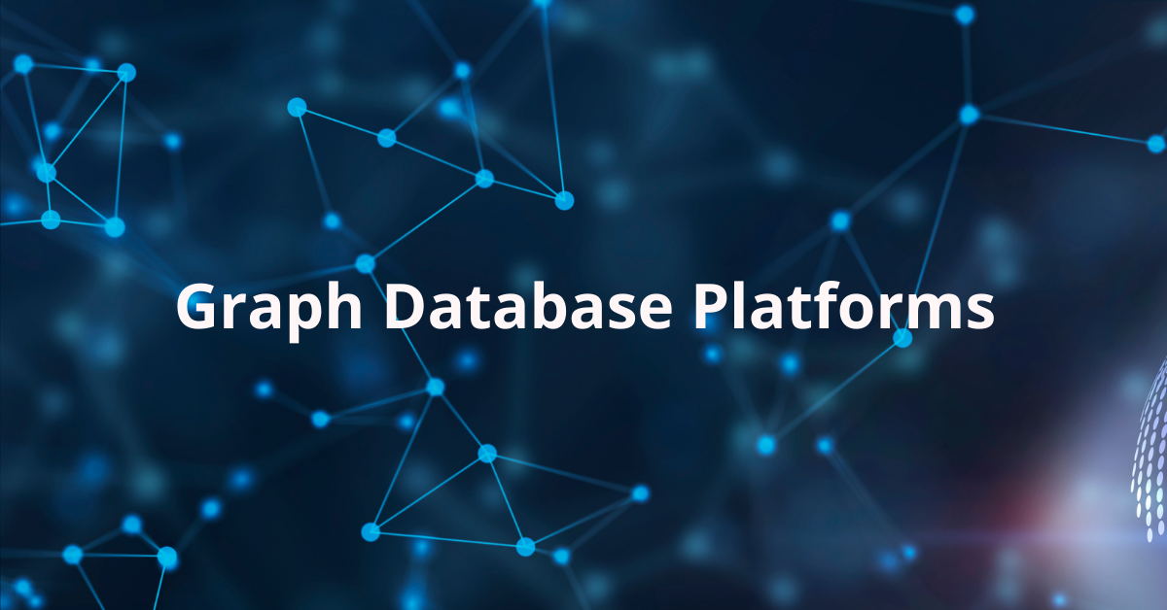

Slide 2
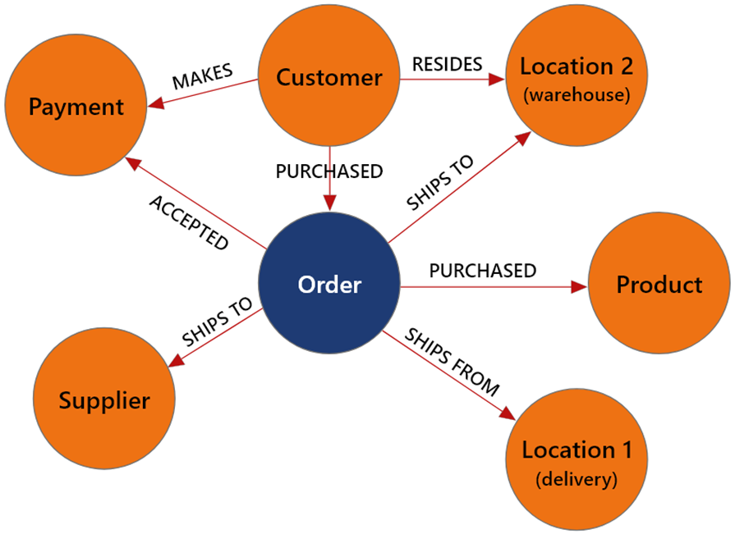
WHAT is Graph Databases?
Graph database is a type of NOSQL Database
graph database stores data in nodes and relationships.
Examples for graph databases,
Social network, recommendation systems
Popular graph databases,
Neo4j, Oracle No SQL Database, OrientDB, HypherGraphDB

Slide 3
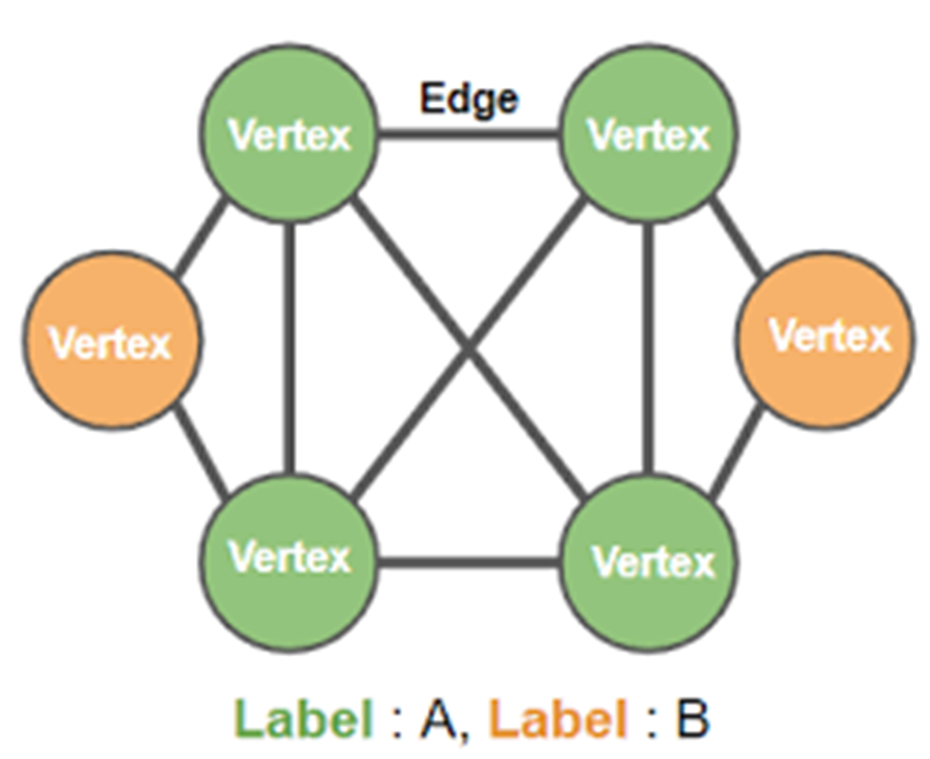
WHY Graph Databases?
Nowadays, the relationship between data is more valuable than the data itself.
RDBMS highly structured. RDBMS does not store the relationships between the data.
Graph database is simpler compared to other databases.
Graph databases can be used with OLTP systems.

Slide 4

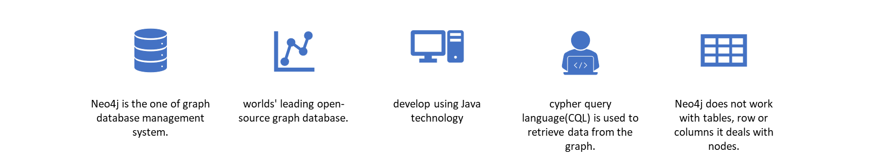
What is Neo4j?
Purpose of Neo4j?
Neo4j delivers the lightning-fast read and write performance you need, while still protecting your data integrity.

Slide 5
Basic components of a Neo4j Graph Database
Node - a node is a data/record in a graph database. This is the fundamental unit of a Graph
Labels – labels are used to group/classify the nodes.
A node or relationship can contain one or more labels.
Relationships – Represent using arrows. Relationships have directions (Unidirectional and Bidirectional).
relationships should be directional.
Properties – key value pairs (node’s data)
Both Nodes and Relationships may contain properties.

Slide 6
When to Use a Graph Database
Here are some points to consider when deciding whether to use a graph database:
graph database is a good choice when your data is highly connected
when the relationships between data points are more important than the data’s value.
When you need to traverse relationships between data entities quickly and efficiently.
When you need to store data that is constantly changing or evolving.
When you need to store data that is not easily represented in a tabular format.

Slide 7
When Not to Use a Graph Database
If you need to manage,
Simple data models: If your data model is simple and doesn’t involve many relationships between data points, a graph database may not be the best choice.
Structured data: If your data is highly structured and doesn’t involve many relationships between data points, a relational database may be a better choice.
then you might want to consider using a more traditional relational database than a NoSQL database.

Slide 8
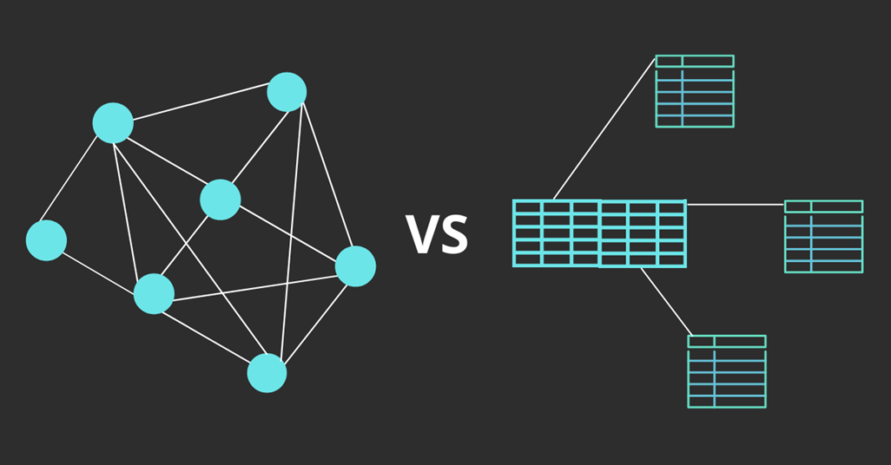
RDBMS VS Graph Databases
RDBMS | Graph Database
Tables | Graph
Rows | Nodes
Columns and Data | Properties and values
Constraints | Relationships
Joins | Traversal

Slide 9

Introduction to Neo4j : Practical Exercises

Slide 10
Summary
Neo4j Clauses :
CREATE Clause : The CREATE clause is used to create nodes and relationships.
MATCH Clause : The MATCH clause in Neo4j is used to retrieve data from the graph database.
LIMIT Clause : LIMIT constrains the number of returned rows.
MERGE Clause : MERGE combines the functions of MATCH and CREATE. It matches existing nodes and binds them or creates new data and binds that if they are not present in the graph.
DELETE Clause : DELETE clause is used to remove data, specifically nodes, relationships, or properties from the database.

Slide 11


